Slide 1

DataBricks Training
By: Gaurav Gangwar

Slide 2
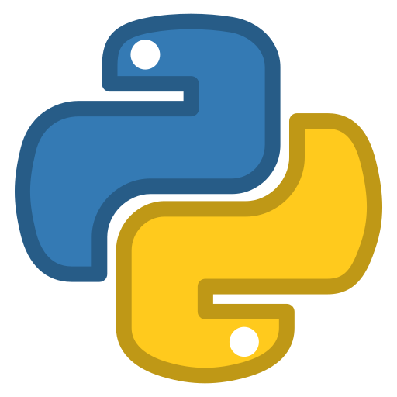


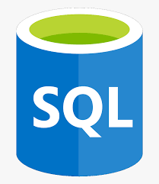

Agenda of the training
Topics to be covered:
Python Basics
SQL Basics
Hadoop
Apache Spark
Databricks
Python Basics
Databricks
Agenda
Spark
SQL Basics
Hadoop

Slide 3
Agenda for today
RDD
Data Frame
Dataset
Databricks Work Space
Databricks Lab

Slide 4
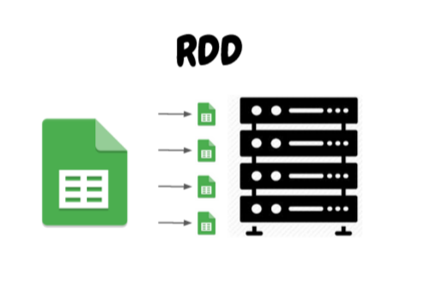
What are RDDs?
RDDs or Resilient Distributed Datasets is the fundamental data structure of the Spark.
It is the collection of objects which is capable of storing the data partitioned across the multiple nodes of the cluster and also allows them to do processing in parallel.
It is fault-tolerant if you perform multiple transformations on the RDD and then due to any reason any node fails. The RDD, in that case, is capable of recovering automatically.
There are 3 ways of creating an RDD:
Parallelizing an existing collection of data
Referencing to the external data file stored
Creating RDD from an already existing RDD

Slide 5
What is Data Frame?
It was introduced first in Spark version 1.3 to overcome the limitations of the Spark RDD.
Spark Dataframes are the distributed collection of the data points, but here, the data is organized into the named columns.
They allow developers to debug the code during the runtime which was not allowed with the RDDs.
Dataframes can read and write the data into various formats like CSV, JSON, AVRO, HDFS, and HIVE tables.
It is already optimized to process large datasets.
It uses a catalyst optimizer for optimization purposes

Slide 6
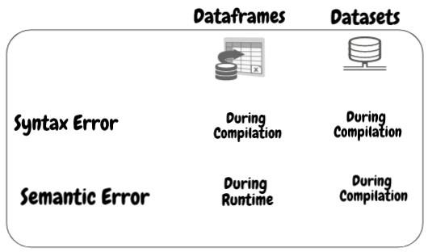
What is Dataset?
Spark Datasets is an extension of Dataframes API with the benefits of both RDDs and the Datasets.
It is fast as well as provides a type-safe interface.
Type safety means that the compiler will validate the data types of all the columns in the dataset while compilation only and will throw an error if there is any mismatch in the data types.

Slide 7
Features of Spark Dataset
Below are the different features mentioned:
1. Type Safety: Dataset provides compile-time type safety. It means that the application’s syntax and analysis errors will be checked at compile time before it runs.
2. Immutability: Dataset is also immutable like RDD and Dataframe. It means we can not change the created Dataset. Every time a new dataset is created when any transformation is applied to the dataset.
3. Schema: Dataset is an in-memory tabular structure that has rows and named columns.
4. Performance and Optimization: Like Dataframe, the Dataset also uses Catalyst Optimization to generate an optimized logical and physical query plan.
5. Programming language: The dataset api is only present in Java and Scala, which are compiled languages but not in Python, which is an interpreted language.
6. Lazy Evaluation: Like RDD and Dataframe, the Dataset also performs the lazy evaluation. It means the computation happens only when action is performed. Spark makes only plans during the transformation phase.
7. Serialization and Garbage Collection: The spark dataset does not use standard serializers(Kryo or Java serialization). Instead, it uses Tungsten’s fast in-memory encoders, which understand the internal structure of the data and can efficiently transform objects into internal binary storage. It uses off-heap data serialization using a Tungsten encoder, and hence there is no need for garbage collection.

Slide 8
RDDs vs Dataframes vs Datasets
 | RDDs | Dataframes | Datasets
Data Representation | RDD is a distributed collection of data elements without any schema. | It is also the distributed collection organized into the named columns | It is an extension of Dataframes with more features like type-safety and object-oriented interface.
Optimization | No in-built optimization engine for RDDs. Developers need to write the optimized code themselves. | It uses a catalyst optimizer for optimization. | It also uses a catalyst optimizer for optimization purposes.
Projection of Schema | Here, we need to define the schema manually. | It will automatically find out the schema of the dataset. | It will also automatically find out the schema of the dataset by using the SQL Engine.
Aggregation Operation | RDD is slower than both Dataframes and Datasets to perform simple operations like grouping the data. | It provides an easy API to perform aggregation operations. It performs aggregation faster than both RDDs and Datasets. | Dataset is faster than RDDs but a bit slower than Dataframes.

Slide 9
What is Lazy Evaluation in Apache Spark?
Lazy evaluation in Spark means that the execution will not start until an action is triggered. In Spark, the picture of lazy evaluation comes when Spark transformations occur.
Advantages of Lazy Evaluation in Spark Transformation
Increases Manageability
Saves Computation and increases Speed
Reduces Complexities
Optimization

Slide 10
What is Transformation in Spark
Spark Transformation is a function that produces new RDD from the existing RDDs. It takes RDD as input and produces one or more RDD as output. Each time it creates new RDD when we apply any transformation. Thus, the so input RDDs, cannot be changed since RDD are immutable in nature.
There are two types of Transformation in spark:
Narrow transformation – In Narrow transformation, all the elements that are required to compute the records in single partition live in the single partition of parent RDD. A limited subset of partition is used to calculate the result.
Eg:
map()
flatMap()
mapPartition()
filter()
sample()
unioun()

Slide 11
Wide Transformation
Wide transformation – In wide transformation, all the elements that are required to compute the records in the single partition may live in many partitions of parent RDD. The partition may live in many partitions of parent RDD.
Eg:
intersecttion()
distinct()
reduceByKey()
groupByKey()
join()
cartesian()
repartition()
coalesce()

Slide 12
RDD Action
An action is one of the ways of sending data from Executer to the driver.
Executors are agents that are responsible for executing a task.
While the driver is a JVM process that coordinates workers and execution of the task.
Eg:
collect()
take()
count()
top()
reduce()
first()
sum()
aggregate()

Slide 13
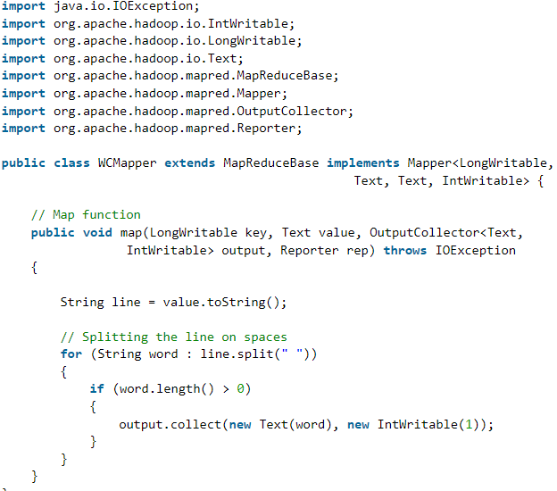
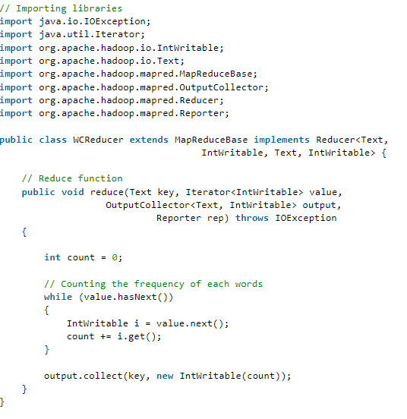
Difference b/w MapReduce and Spark program
Map Reduce program for word count:
Mapper
Map Reduce program for word count:
Reducer

Slide 14

Difference b/w MapReduce and Spark program
Spark Program for Word count:

Slide 15
Introduction of Databricks
Azure Databricks is a data analytics platform optimized for the Microsoft Azure cloud services platform.
Azure Databricks offers three environments for developing data intensive applications:
Databricks SQL.
Databricks Data Science & Engineering.
Databricks Machine Learning.

Slide 16
Databricks Workspace Type
Databricks SQL: provides an easy-to-use platform for analysts who want to run SQL queries on their data lake, create multiple visualization types to explore query results from different perspectives, and build and share dashboards.
Databricks Data Science & Engineering : Provides an interactive workspace that enables collaboration between data engineers, data scientists, and machine learning engineers. For a big data pipeline, the data (raw or structured) is ingested into Azure through Azure Data Factory in batches, or streamed near real-time using Apache Kafka, Event Hub, or IoT Hub. This data lands in a data lake for long term persisted storage, in Azure Blob Storage or Azure Data Lake Storage. As part of your analytics workflow, use Azure Databricks to read data from multiple data sources and turn it into breakthrough insights using Spark.
Databricks Machine Learning: It is an integrated end-to-end machine learning environment incorporating managed services for experiment tracking, model training, feature development and management, and feature and model serving.

Slide 17
Databricks Notebook & it’s Features
A Databrick Notebook is a web-based interface to a document with runnable code, narrative text, and visualizations.
Multiple Programming Languages: It can work with Python, R, Java, Scala.
Quick Visualization: It gives option to quickly visualise the data of dataframe.
Download CSV: It gives option to quickly download the data of dataframe in csv.
Revision History: It will keep you changes in revision history.
Cell Runtime: it will provide runtime or execution time for particular sell.

Slide 18
Creating and Managing Cluster
There are two types of clusters:
All-Purpose clusters:
Can be shared by multiple users.
These are typically used to run notebooks.
All-Purpose clusters remain active until you terminate them.
Job clusters:
You create a job cluster when you create a job.
Such clusters are terminated automatically after the job is completed.

Slide 19
Cluster Mode & Access Mode
There are two type of Modes in databricks cluster:
Single Node
Multi Node
There are three type of Access Modes in databricks cluster:
Single User
Shared
No Isolation Shared

Slide 20
Cluster Node Type
Driver node - Node to execute Driver program.
Worker node - Node to execute Worker program
GPU instance types - Node to work with graphical processing.
Spot instances – Spot Instance is base on avilbility.

Slide 21
Discovering Databricks with Azure
Creating Account on Azure Databrciks.

